Slide 1
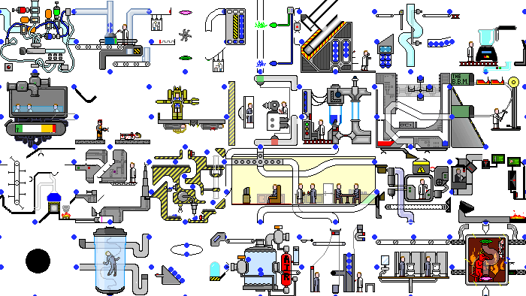
GPars:
Unsung Hero of Concurrency in Practice
http://playstationna.i.lithium.com/t5/image/serverpage/image-id/432281iDADEAFC04868CE5C?v=1.0

Slide 2
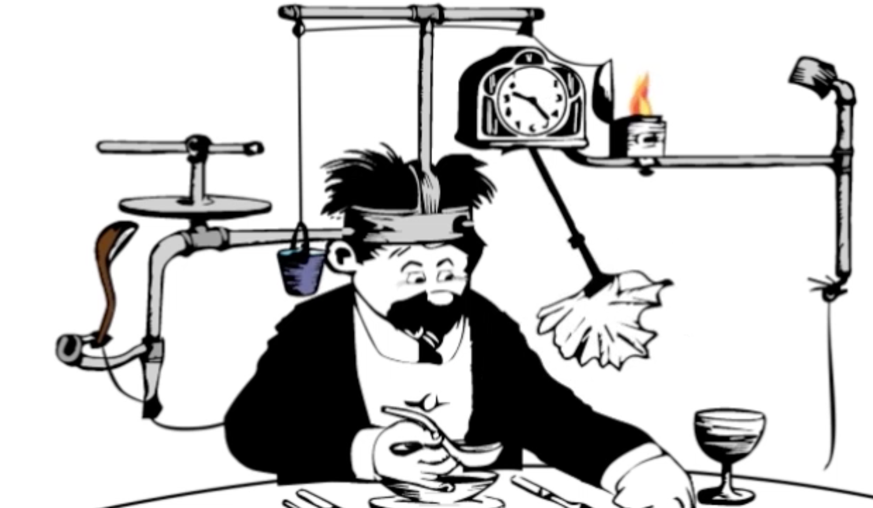
Yaroslav Yermilov Senior Software Engineer EPAM Systems https://yermilov.github.io/ https://twitter.com/yermilov17 https://www.facebook.com/yaroslav.yermilov https://ua.linkedin.com/pub/yaroslav-yermilov/58/682/506
work for EPAM Systems since 2011 in office - clustering, Big Data and automated testing out of office - Groovy
https://motherboard.vice.com/en_us/article/inside-rube-goldberg-machine-youtube-video-artist-joseph-herschers-bedroom-workshop

Slide 3
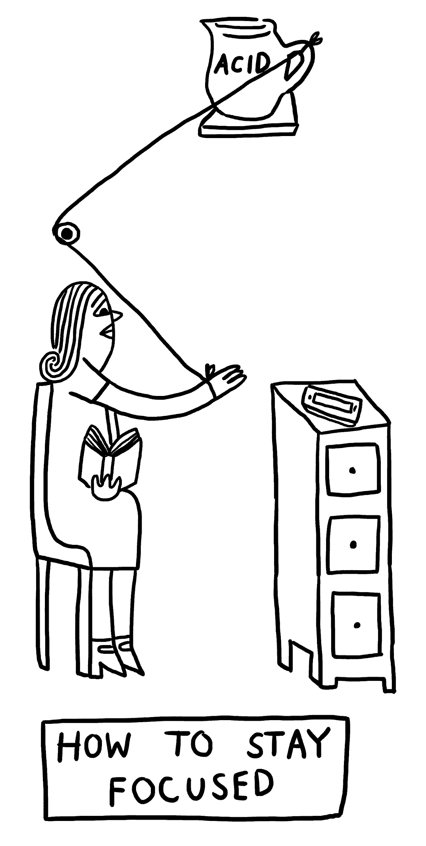
Focus for this talk
two guidelines for developing concurrent code
how Java handles concurrent/parallel development?
GPars place in this picture
how GPars handles concurrent/parallel development?
why and when use GPars?
why and when do not use GPars?
http://www.theverge.com/2015/4/22/8381963/rube-goldberg-machine-contest-history-ideas

Slide 4
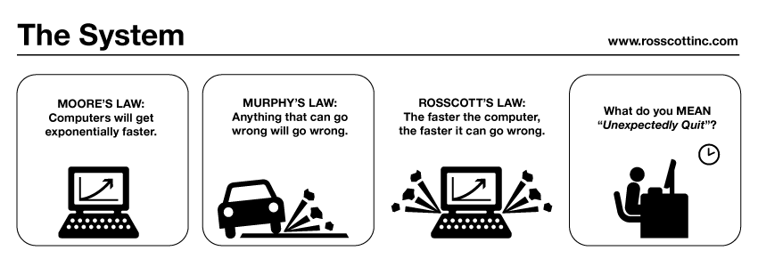
guideline #2 for developing concurrent code
public class Holder {
private int n;
public Holder(int n) { this.n = n; }
public void assertSanity() {
if (n != n) {
throw new AssertionError("Even it can go wrong!");
}
}
}
public class Initializer {
public Holder holder;
public void init() { holder = new Holder(42); }
}
public class Holder {
private int n;
public Holder(int n) { this.n = n; }
public void assertSanity() {
if (n != n) {
throw new AssertionError("Even it can go wrong!");
}
}
}
public class Initializer {
public Holder holder;
public void init() { holder = new Holder(42); }
}
MURPHY’S LAW:
Anything that can go wrong will go wrong.
http://www.systemcomic.com/2009/04/27/the-system-197

Slide 5
guideline #1 for developing concurrent code
MOORE’S LAW:
Computers will get exponentially faster.
http://www.systemcomic.com/2009/04/27/the-system-197

Slide 6
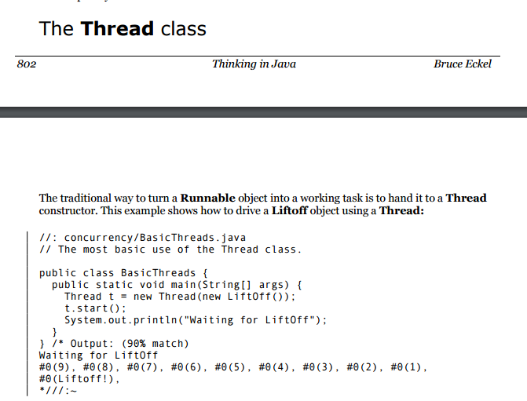

Slide 7
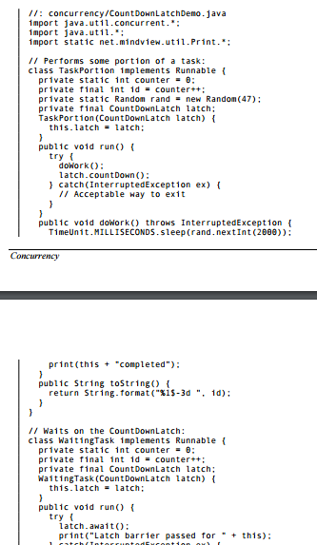
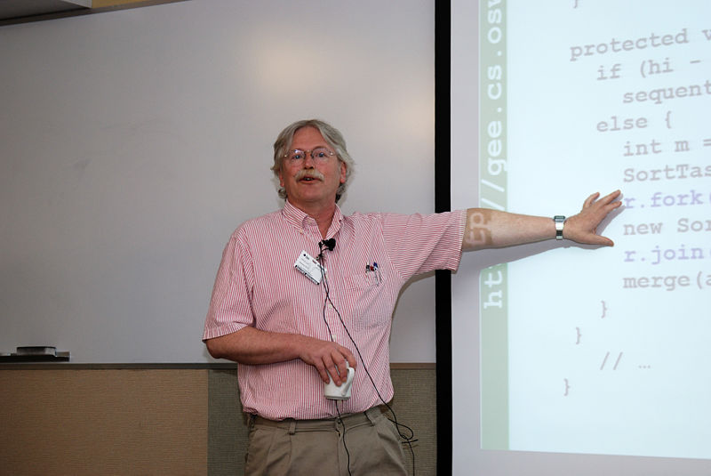
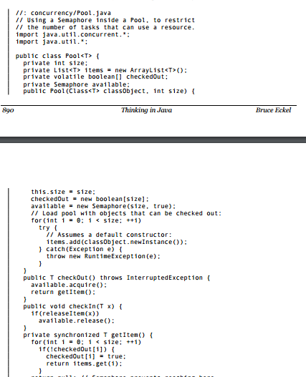
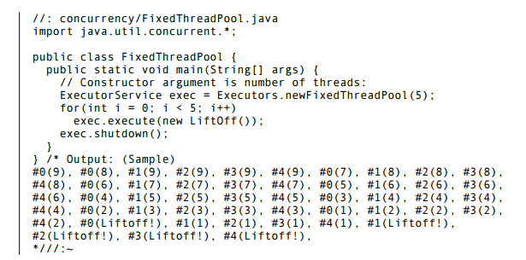
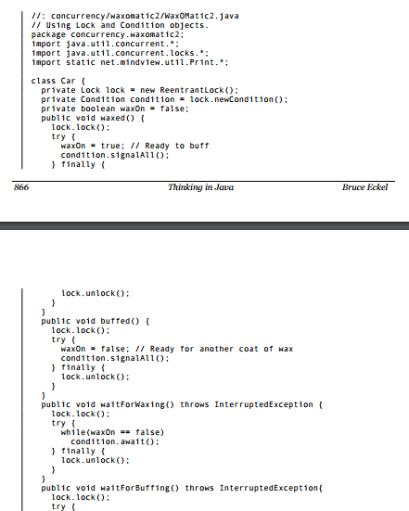
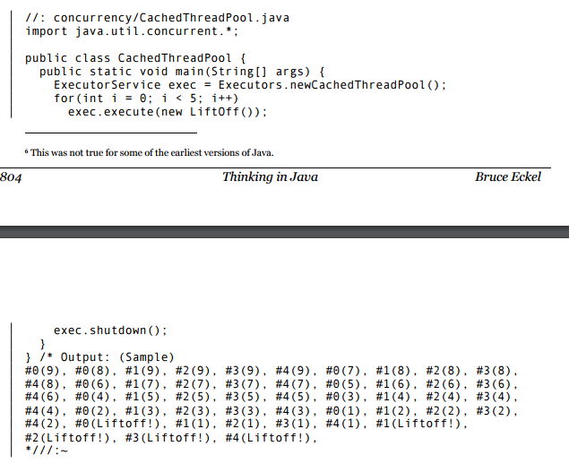
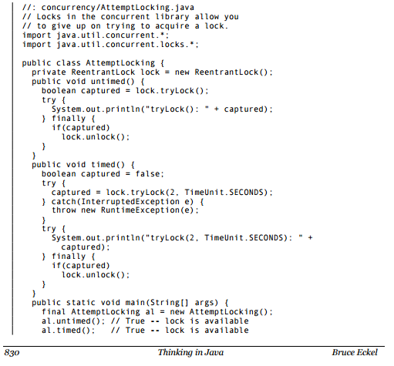
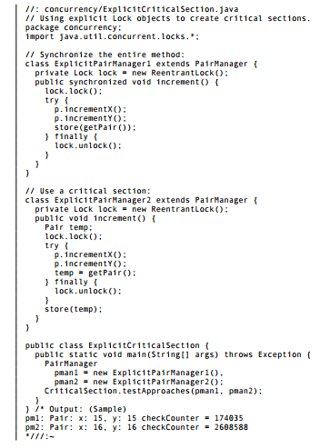
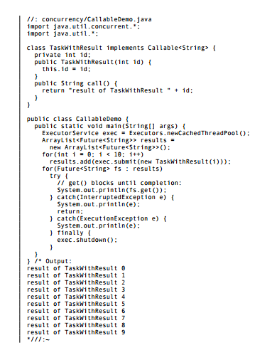
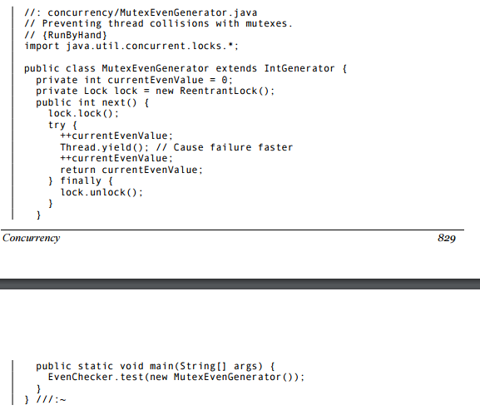
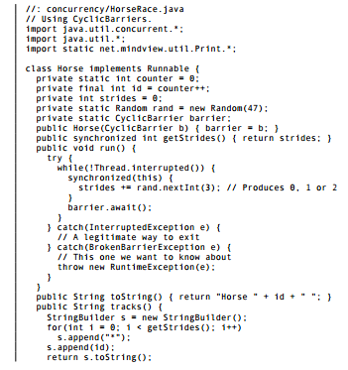
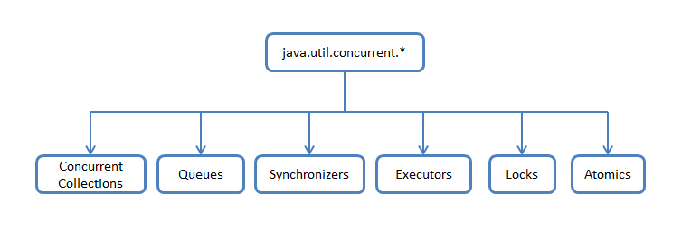
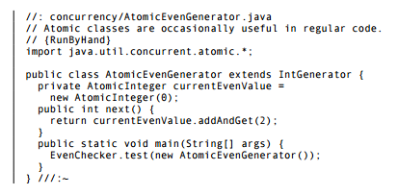
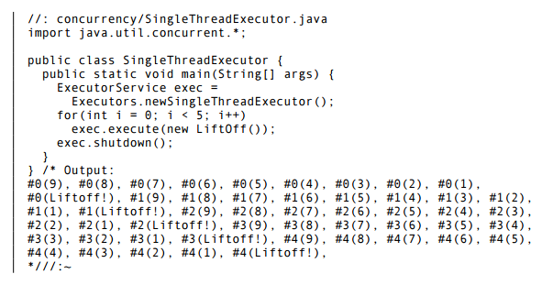

Slide 8
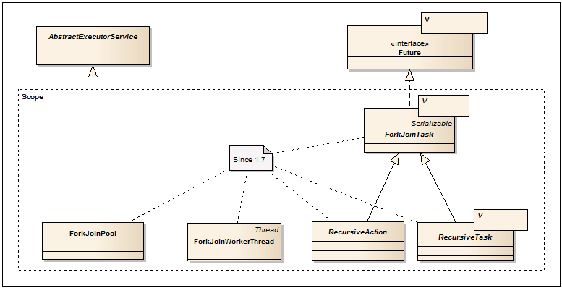

Slide 9
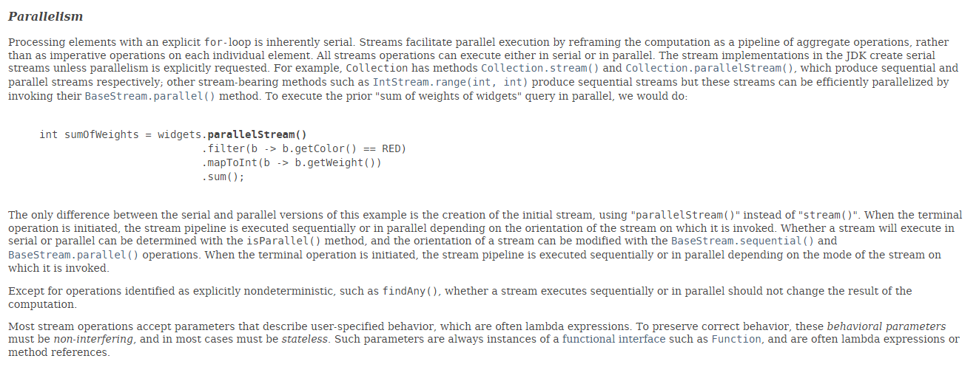

Slide 10
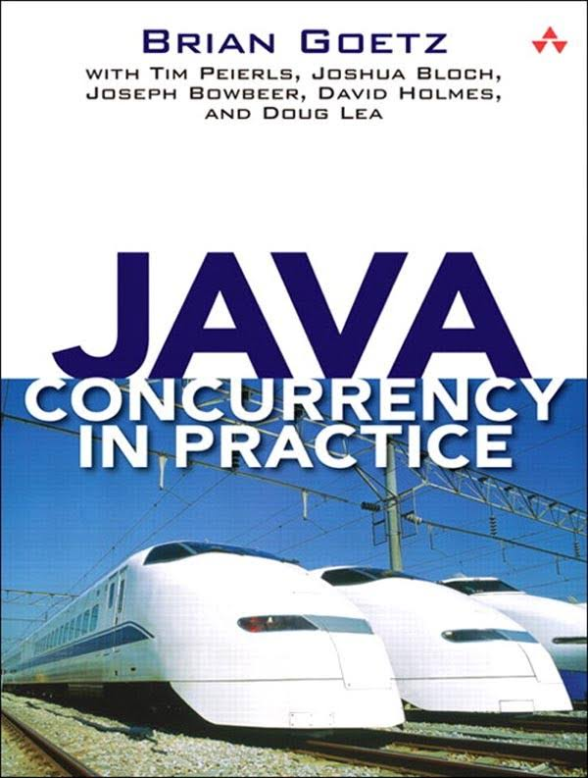
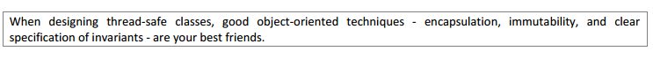
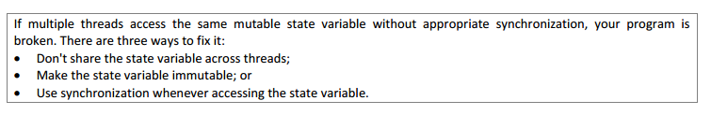

Slide 11

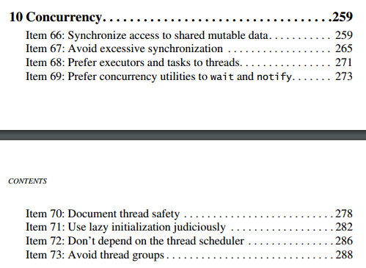

Slide 12
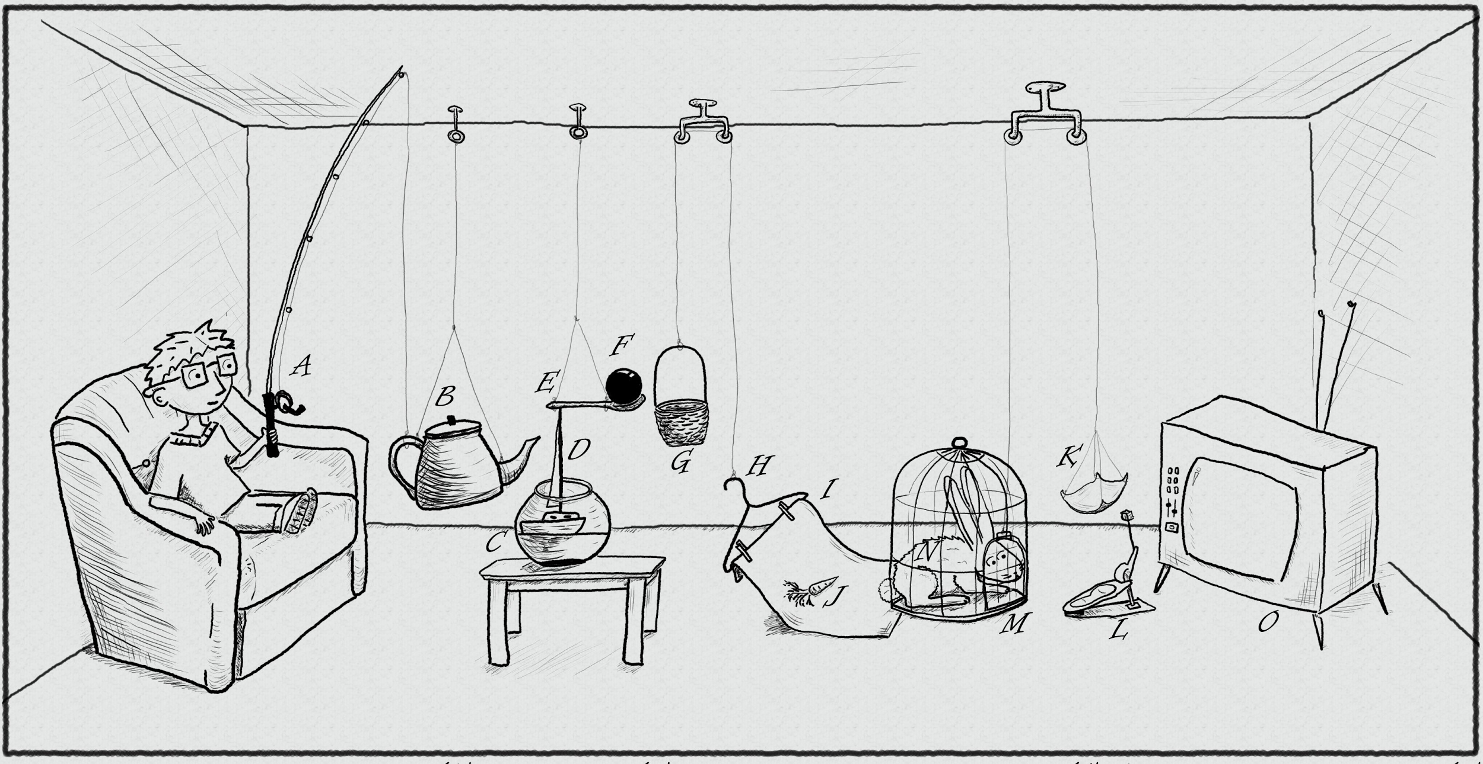
The traditional thread-based concurrency model built into Java doesn’t match well with the natural human sense for parallelism.
https://www.pinterest.com/pin/395190936024778319/

Slide 13
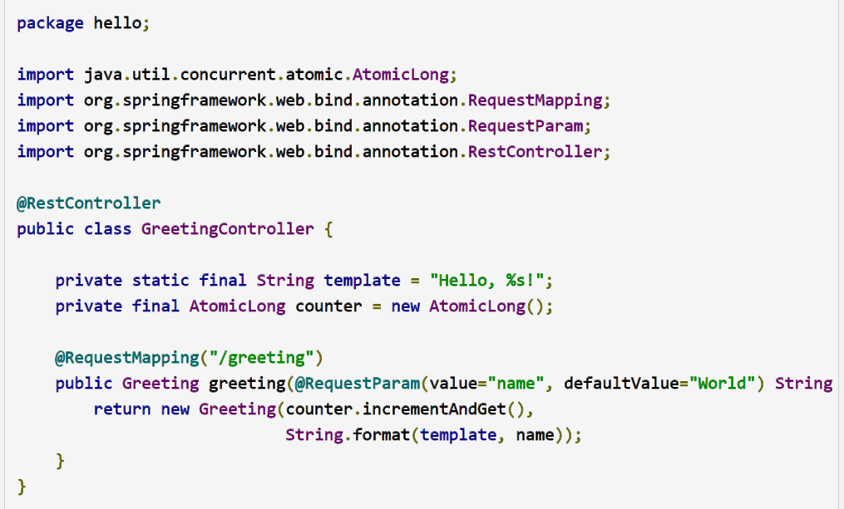
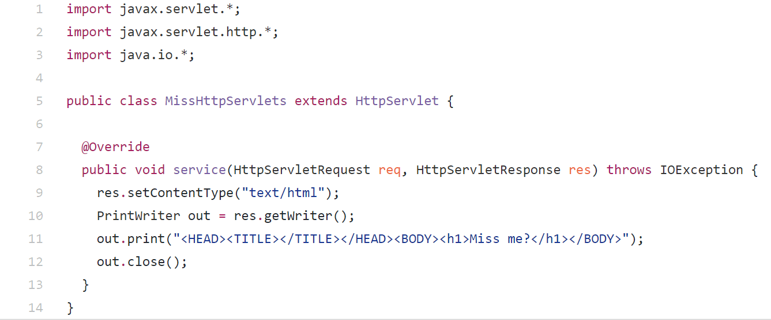

Slide 14
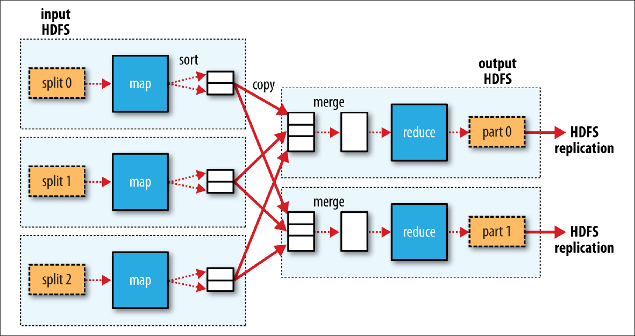

Slide 15
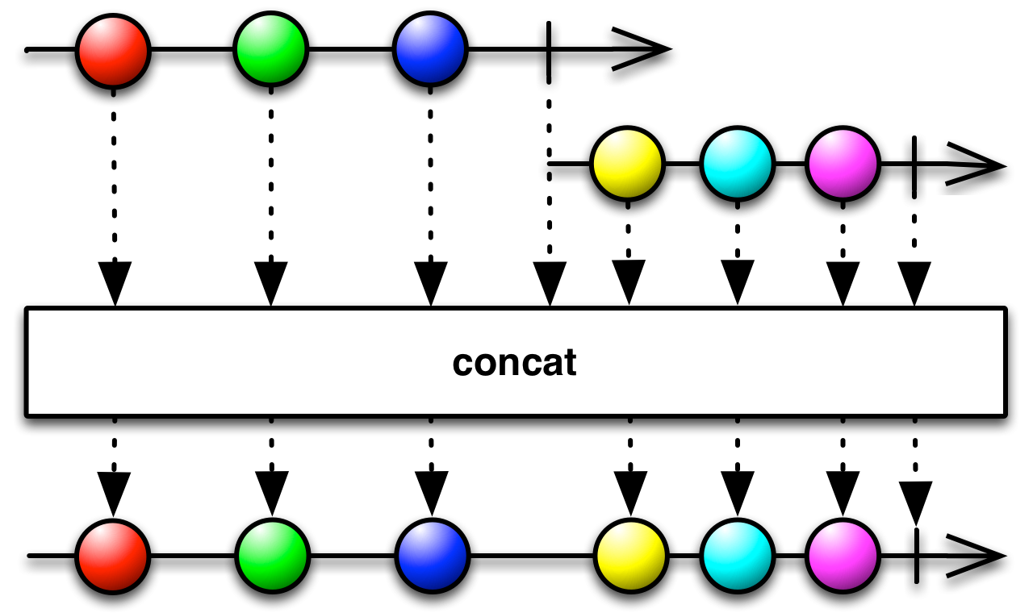
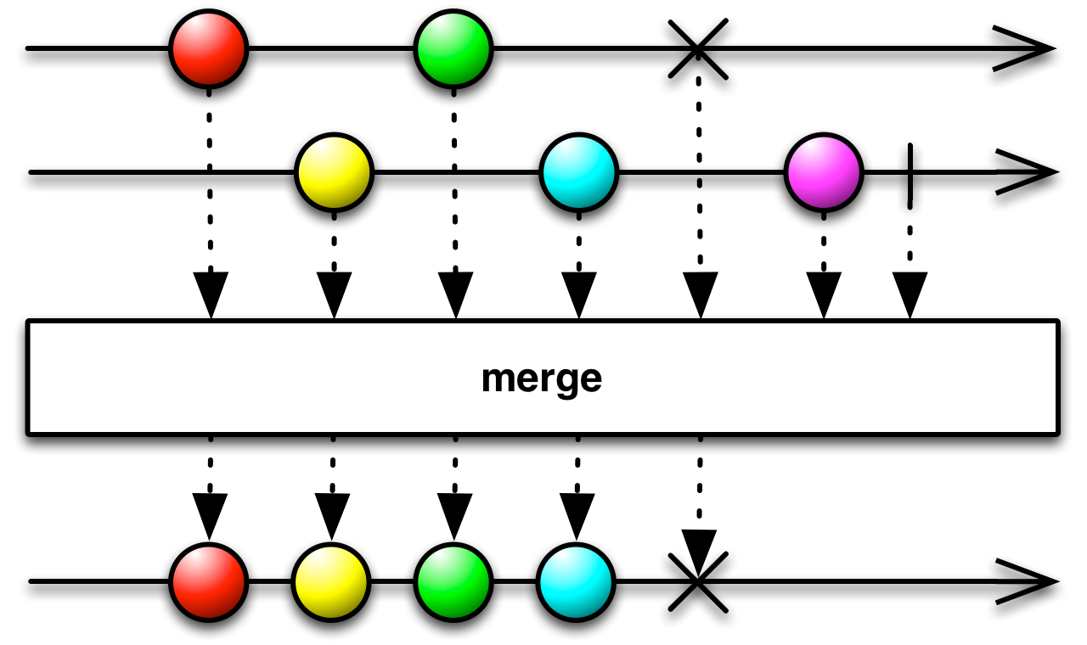
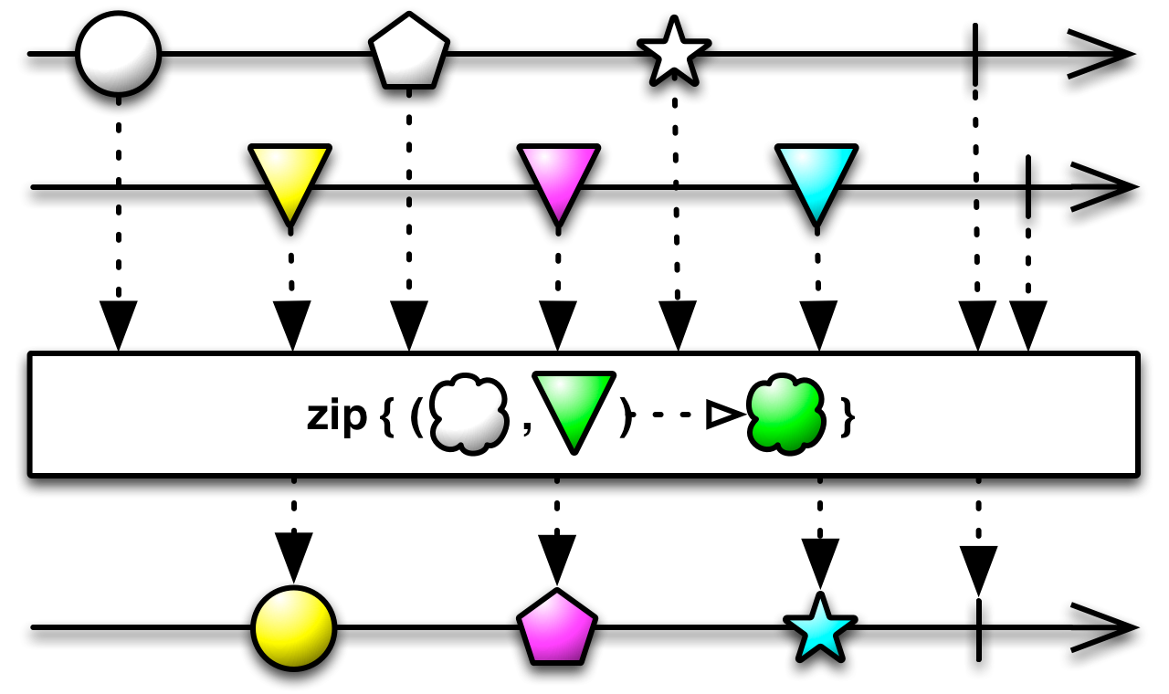
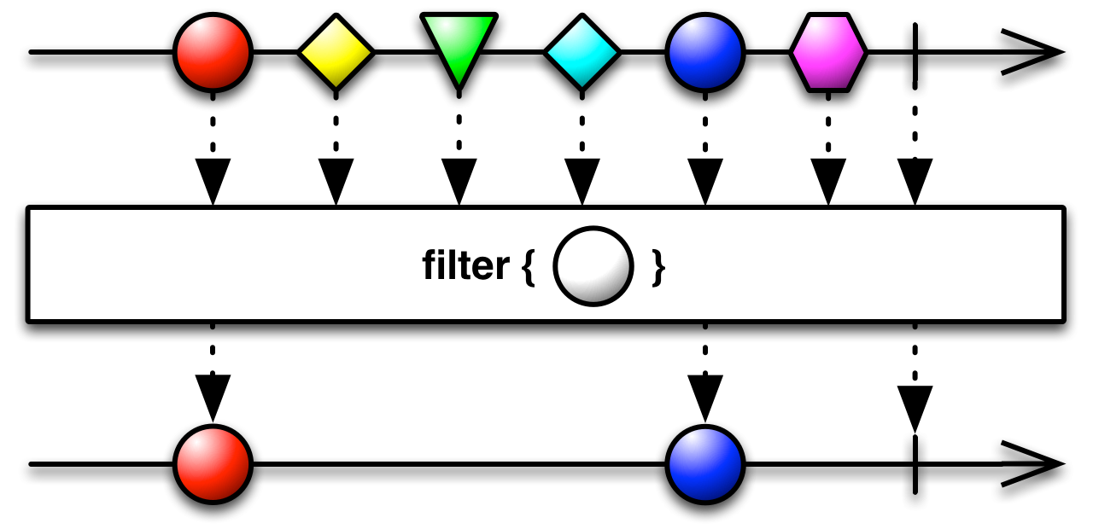
http://reactivex.io/RxJava/2.x/javadoc/io/reactivex/Flowable.html

Slide 16


Slide 17
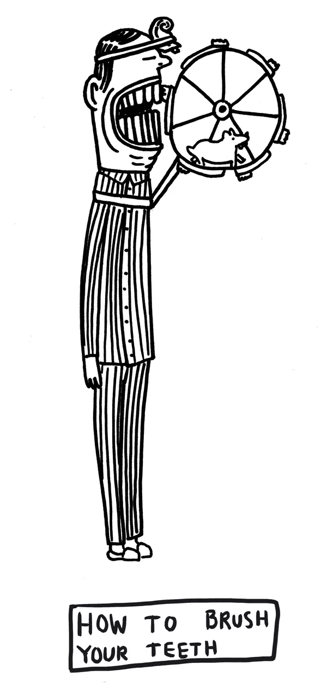
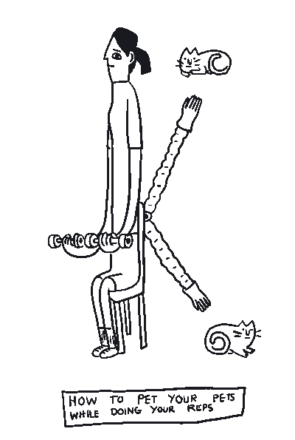
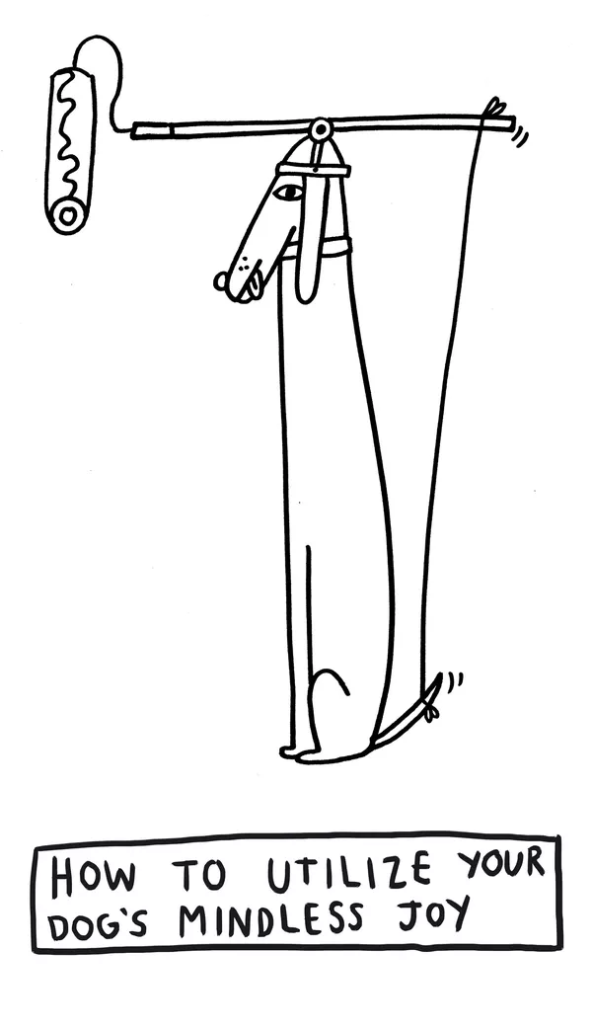
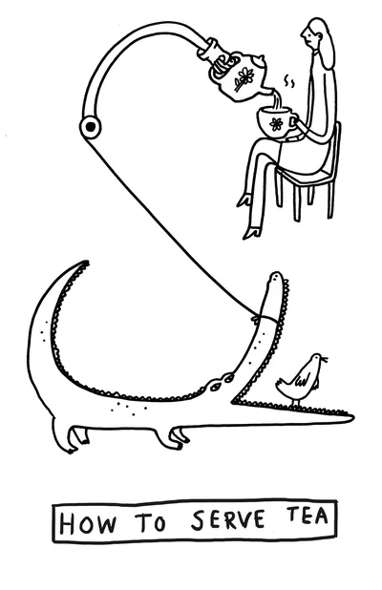
GPars:
map/reduce fork/join asynchronous closures actors agents dataflows
http://www.theverge.com/2015/4/22/8381963/rube-goldberg-machine-contest-history-ideas

Slide 18
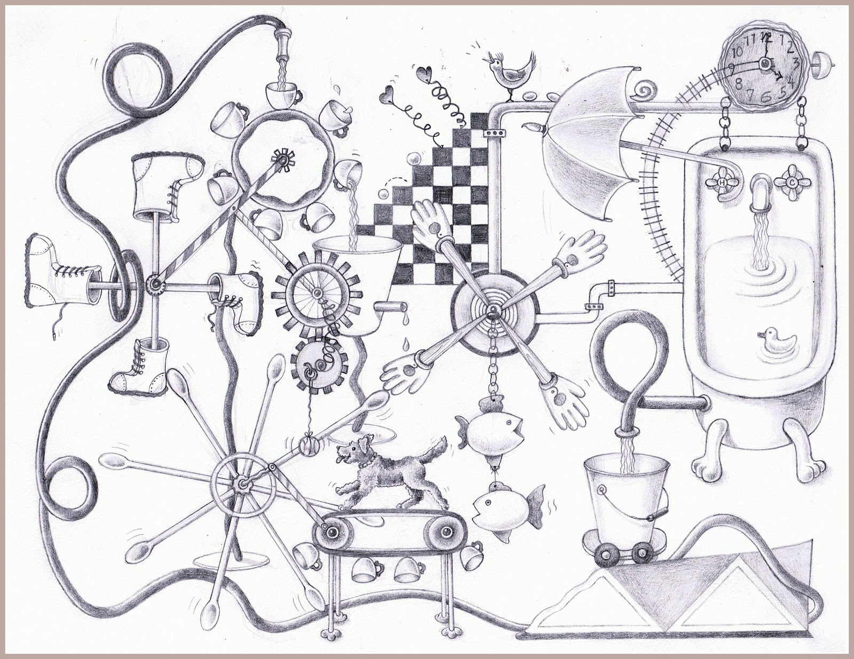
DEMO
https://www.pinterest.com/pin/527554543837493577/

Slide 19
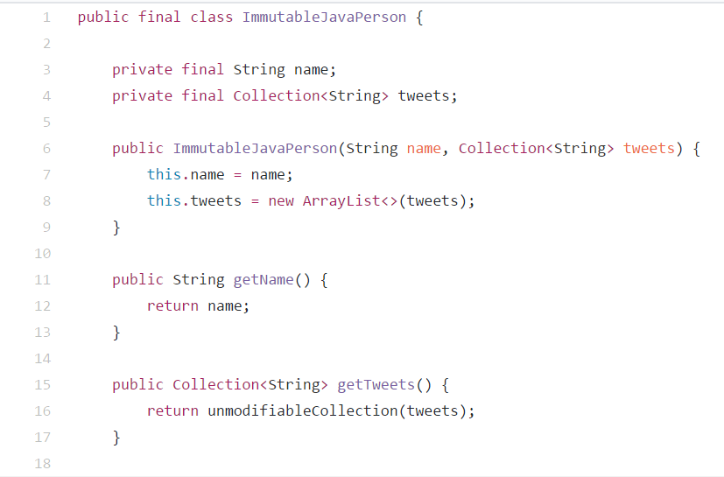

Slide 20
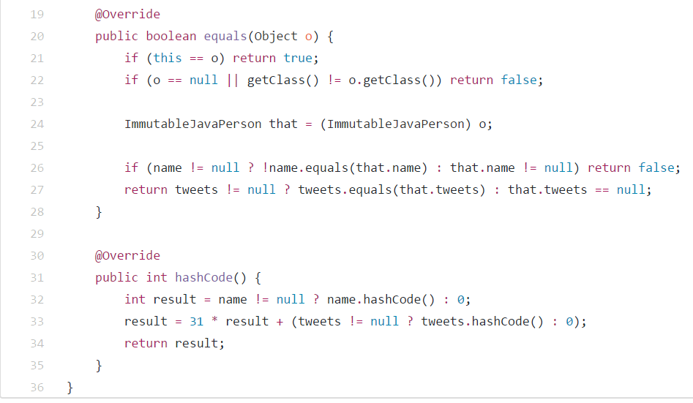

Slide 21
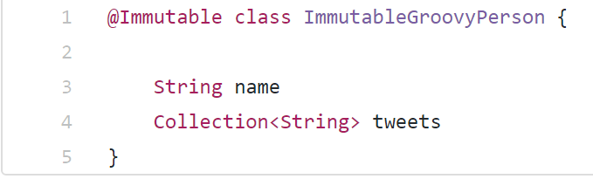

Slide 22
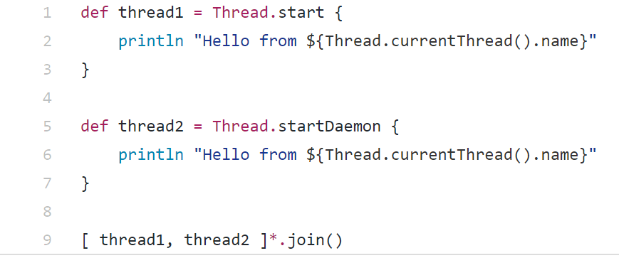

Slide 23
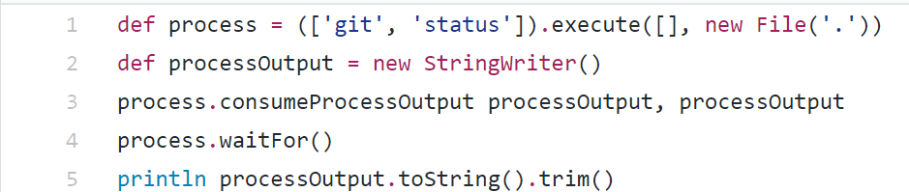

Slide 24
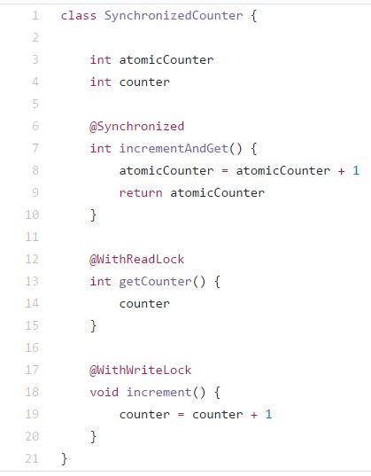

Slide 25
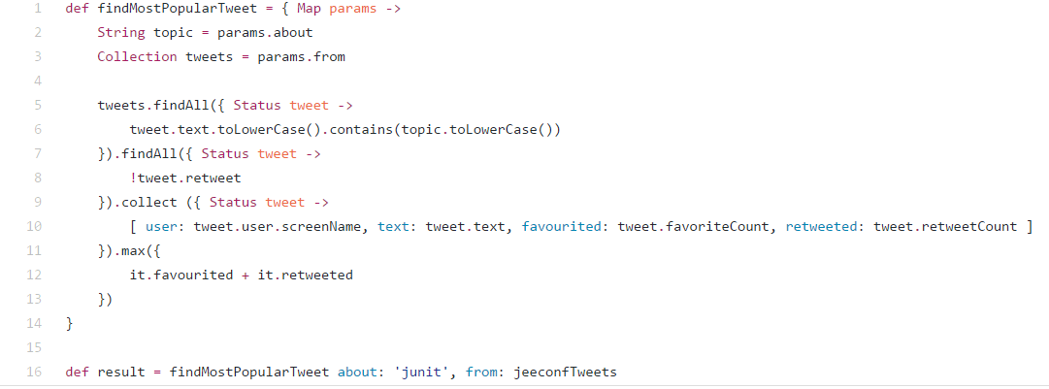

Slide 26
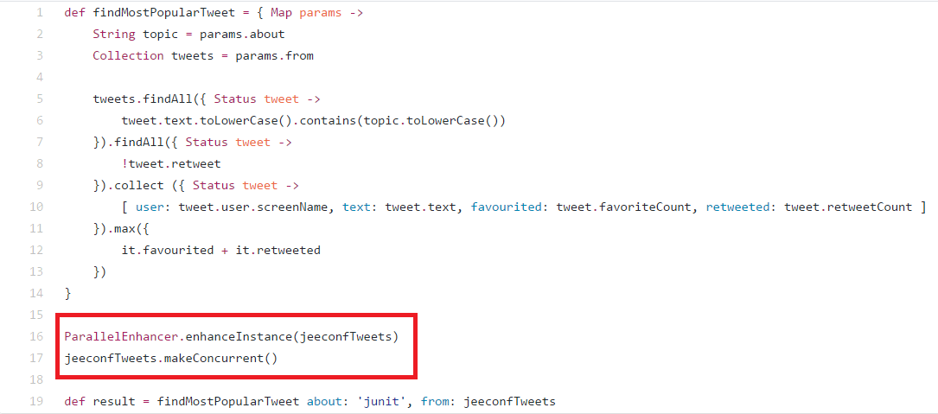

Slide 27
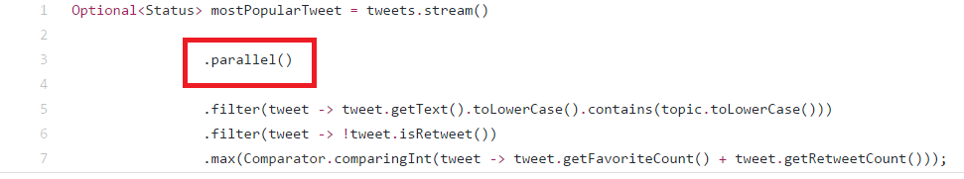

Slide 28
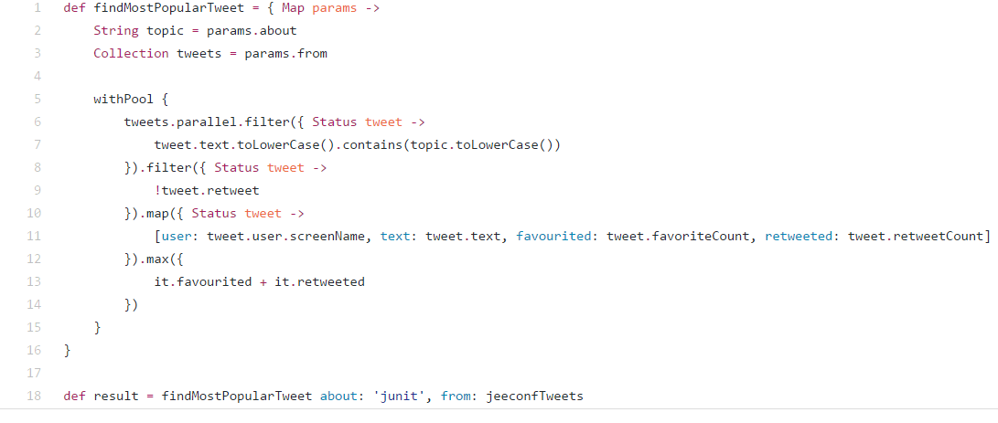

Slide 29
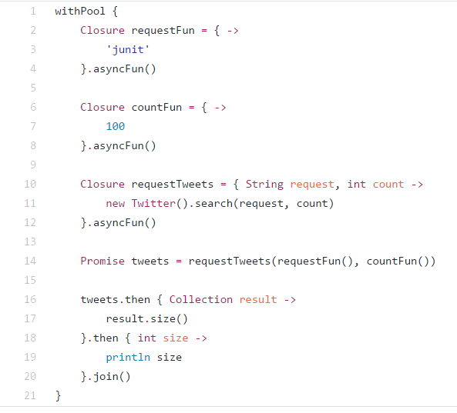

Slide 30
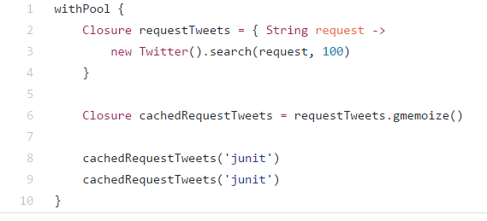

Slide 31
why and when use GPars?

Slide 32
why and when do not use GPars?

Slide 33
Further dive

